Slide 1
What is Data Compression

Slide 2
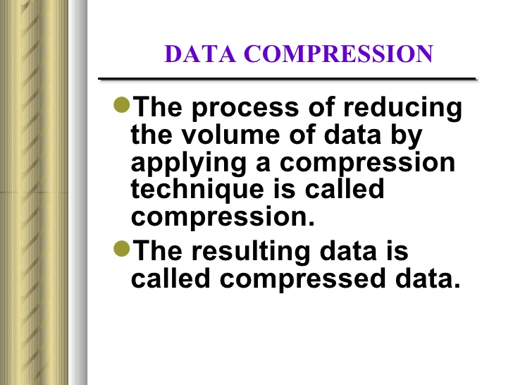

Slide 3
HIERARCHY OF COMPRESSION METHODS

Slide 4
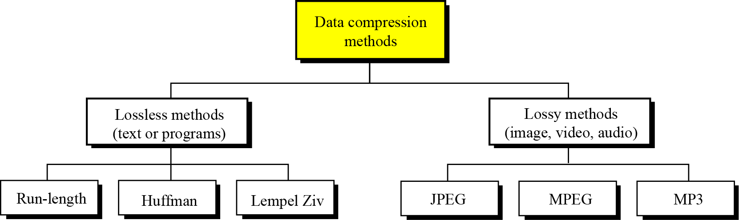
Data compression implies sending or storing a smaller number of bits. Although many methods are used for this purpose, in general these methods can be divided into two broad categories: lossless and lossy methods.

Slide 5
LOSSLESS AND LOSSY COMPRESSION METHODS

Slide 6
LOSSLESS COMPRESSION
In lossless data compression, the integrity of the data is preserved. The original data and the data after compression and decompression are exactly the same because, in these methods, the compression and decompression algorithms are exact inverses of each other: no part of the data is lost in the process. Redundant data is removed in compression and added during decompression. Lossless compression methods are normally used when we cannot afford to lose any data.

Slide 7
LOSSY COMPRESSION METHODS
Our eyes and ears cannot distinguish subtle changes. In such cases, we can use a lossy data compression method. These methods are cheaper—they take less time and space when it comes to sending millions of bits per second for images and video.
Several methods have been developed using lossy compression techniques. JPEG (Joint Photographic Experts Group) encoding is used to compress pictures and graphics, MPEG (Moving Picture Experts Group) encoding is used to compress video, and MP3 (MPEG audio layer 3) for audio compression.

Slide 8
DIFFERENCES BETWEEN LOSSY AND LOSSLESS COMPRESSION

Slide 9
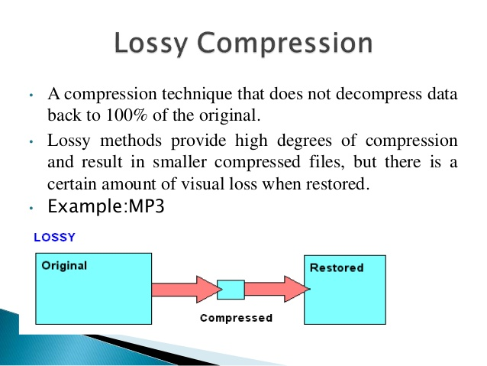

Slide 10
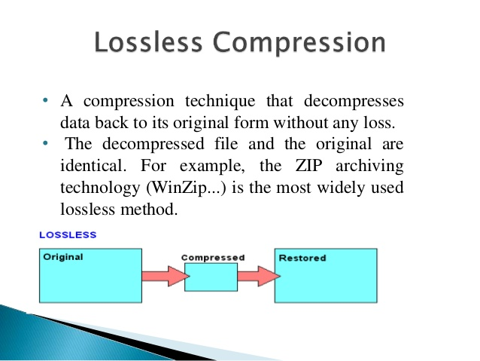

Slide 11
1.What is Image Compression 2.Steps in Image Compression

Slide 12
Image Compression
Image files may be too big for network transmission, even at low resolutions.
Use more sophisticated data representation or discard information to reduce data size.
Effectiveness of compression will depend on actual image data.
For any compression scheme, there will always be some data for which 'compressed' version is actually bigger than the original.

Slide 13
Steps in Image Compression
Picture Preparation
Picture Processing
Quanti- zation
Entropy Encoding
Image Uncompressed
Image Compressed
1. Preparation: analog to digital conversion.
2. Processing: transform data into a domain easier to compress.
3. Quantization: reduce precision at which the output is stored.
4. Entropy encoding: remove redundant information in the resulting data stream.

Slide 14
Disadvantages of Audio Compression

Slide 15
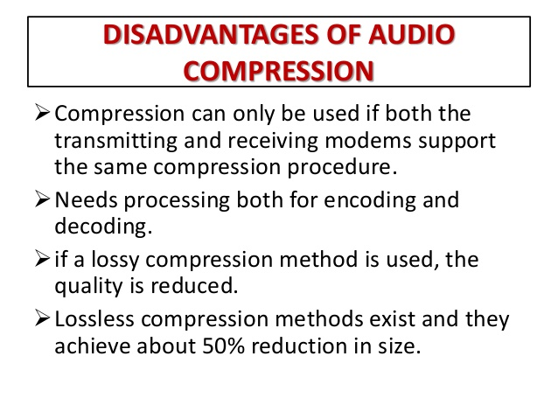

Slide 16
DCT(DISCRETE COSINE TRANSFORM)

Slide 17
Discrete cosine transform (DCT)
In this step, each block of 64 pixels goes through a transformation called the discrete cosine transform (DCT).
The transformation changes the 64 values so that the relative relationships between pixels are kept but the redundancies are revealed.
P(x, y) defines one value in the block, while T(m, n) defines the value in the transformed block.

Slide 18
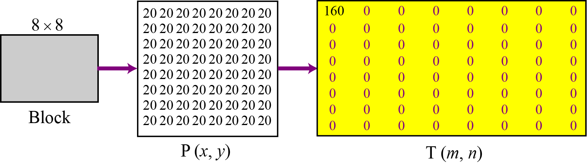
To understand the nature of this transformation, let us show the result of the transformations for three cases.
Figure : Case 1: uniform grayscale

Slide 19
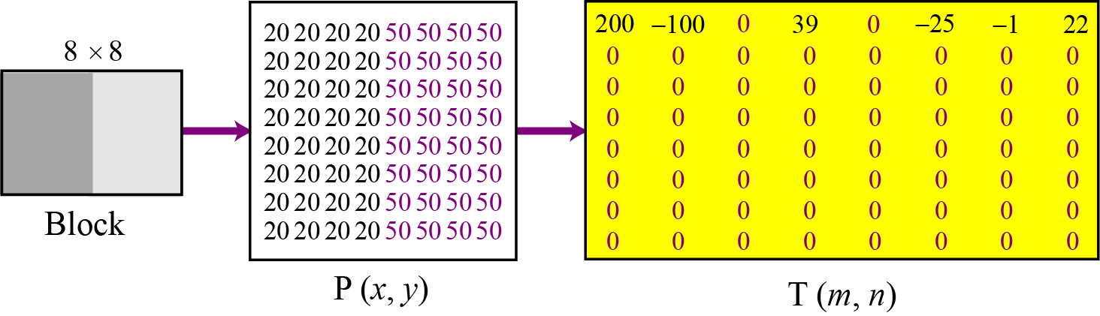
Figure : Case 2: two sections

Slide 20
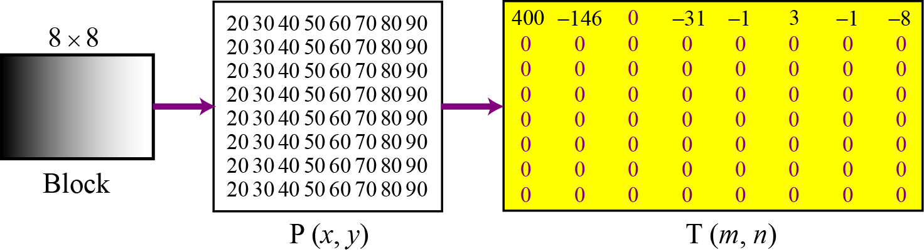
Figure 15.14 Case 3: gradient grayscale

Slide 21
Quantization
1. After the T table is created, the values are quantized to reduce the number of bits needed for encoding.
2. Quantization divides the number of bits by a constant and then drops the fraction.
3. This reduces the required number of bits even more.
.

Slide 22
Compression
After quantization the values are read from the table, and redundant 0s are removed.
However, to cluster the 0s together, the process reads the table diagonally in a zigzag fashion rather than row by row or column by column.
The reason is that if the picture does not have fine changes, the bottom right corner of the T table is all 0s.

Slide 23
JPEG COMPRESSION PROCESS

Slide 24
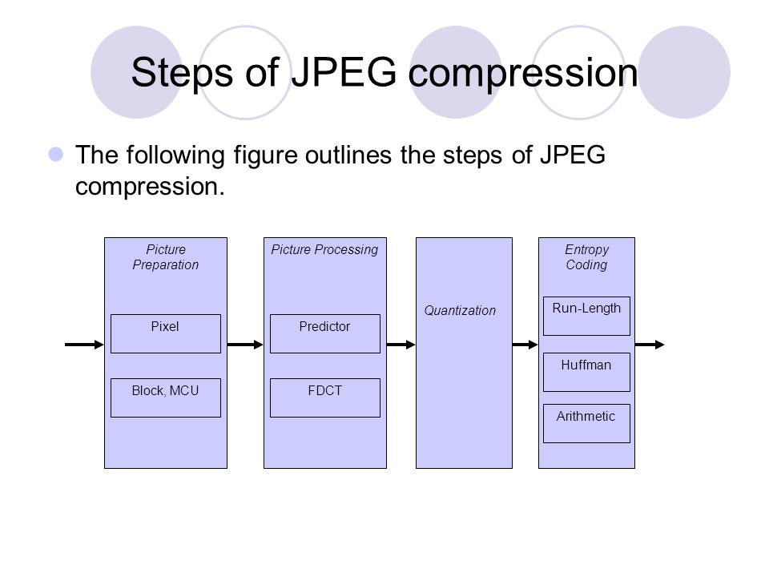

Slide 25
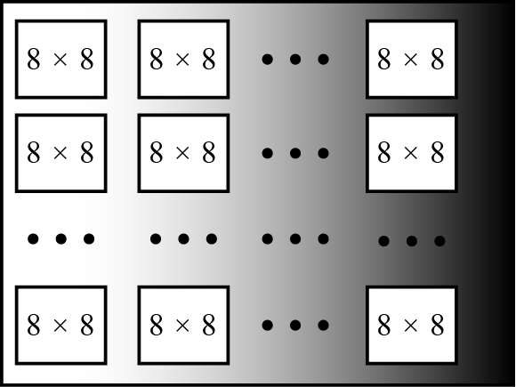
Figure : JPEG grayscale example, 640 × 480 pixels

Slide 26
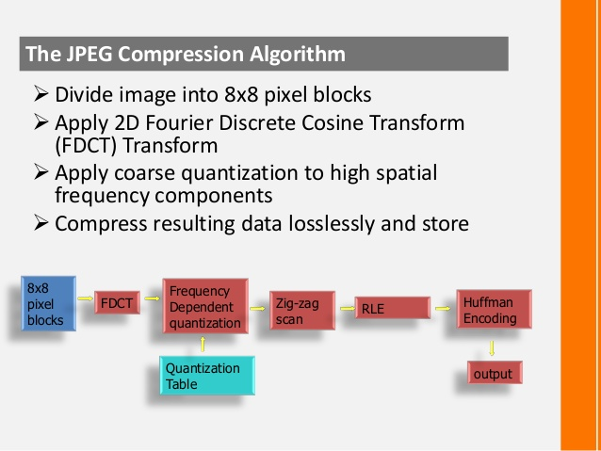

Slide 27
JPEG Encoder- Block Diagram

Slide 28
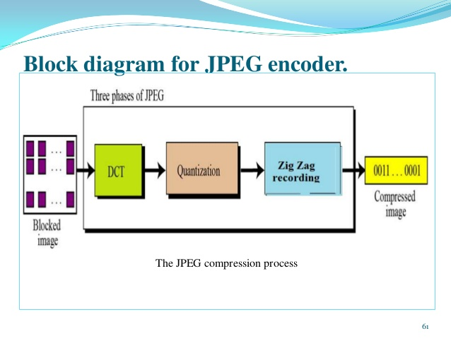

Slide 29
BASIC STEPS OF MPEG VIDEO COMPRESSION DIAGRAM

Slide 30
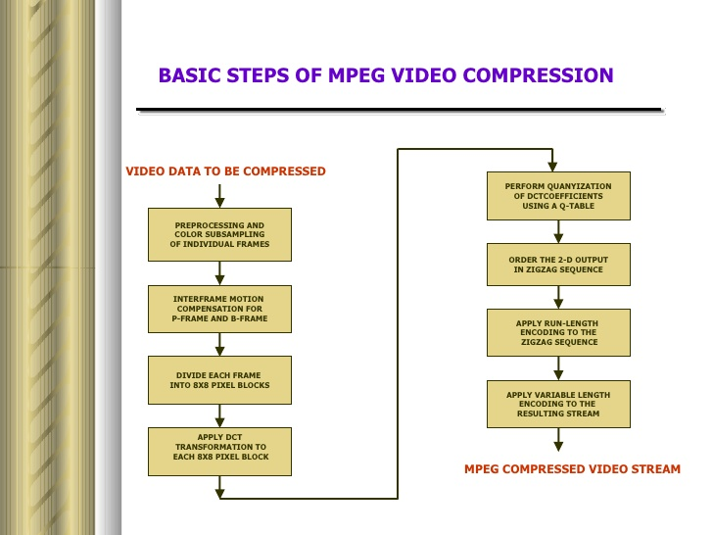

Slide 31
VGA AND ITS FUNCTION

Slide 32
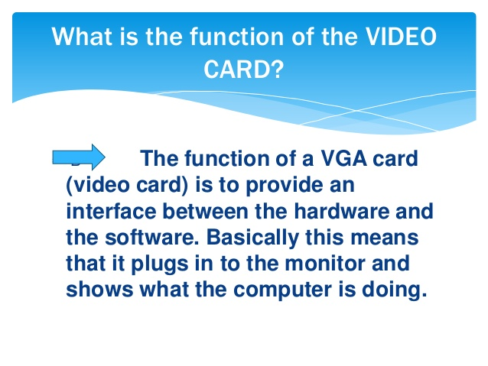

Slide 33
RUN-LENGTH ENCODING

Slide 34
Run-length encoding
Run-length encoding is probably the simplest method of compression. It can be used to compress data made of any combination of symbols. It does not need to know the frequency of occurrence of symbols and can be very efficient if data is represented as 0s and 1s.
The general idea behind this method is to replace consecutive repeating occurrences of a symbol by one occurrence of the symbol followed by the number of occurrences.
The method can be even more efficient if the data uses only two symbols (for example 0 and 1) in its bit pattern and one symbol is more frequent than the other.

Slide 35
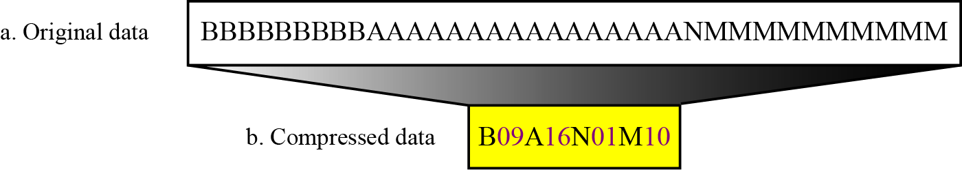

Slide 36
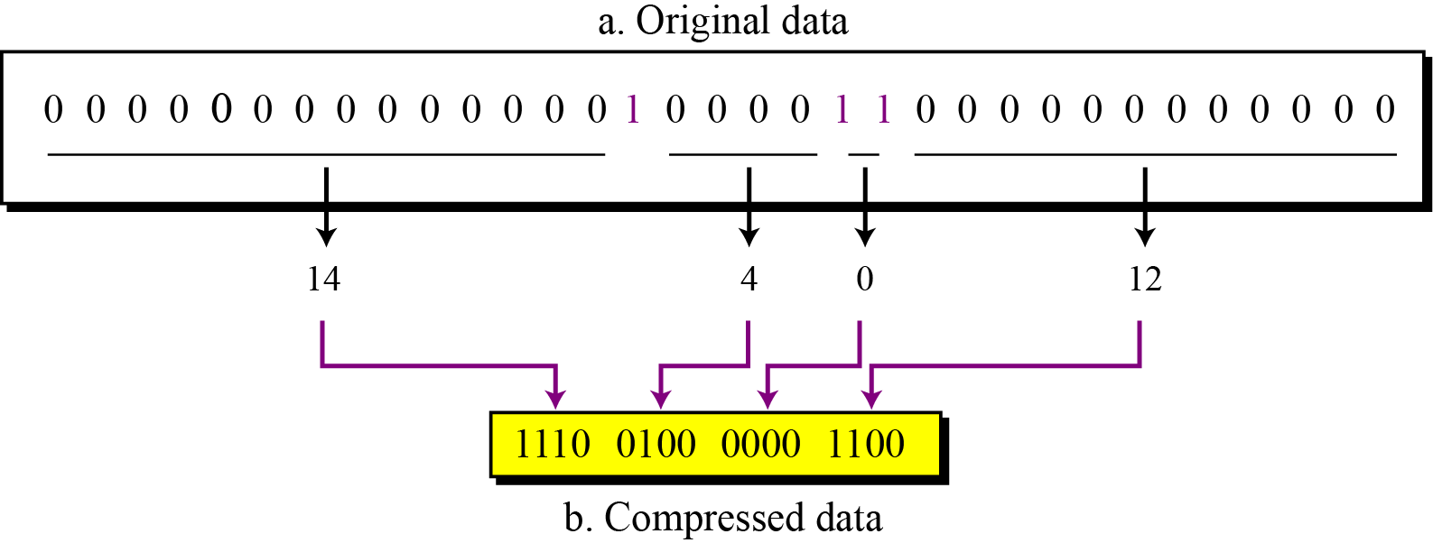
Figure :Run-length encoding for two symbols

Slide 37
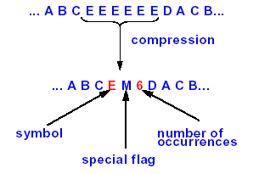
Run-Length Coding
Assumption
Long sequences of identical symbols
Example

Slide 38
MPEG-7 Standard Objective Features Application

Slide 39
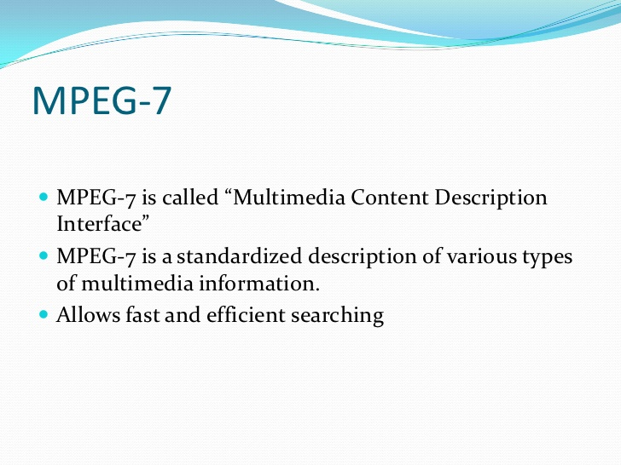

Slide 40
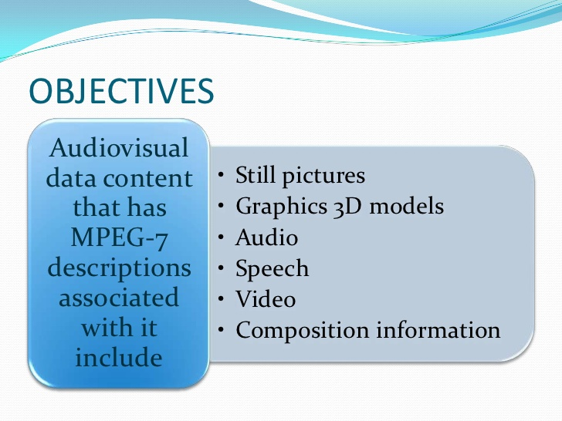

Slide 41
MPEG-7 Systems  Defines: 
Streaming metadata in parallel to audio/video content  Metadata protocol stack model  Optimized metadata representation 
Features: 
1.Abstract MPEG-7 system architecture  2.Optimized binary format for metadata  3.Support for any transmission mode (push/pull) 
4.Bi-directional mapping of metadata

Slide 42
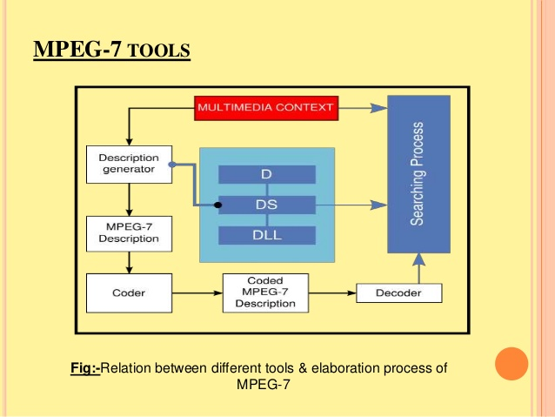

Slide 43
